Slide 1
QA Cinema Project
Team PO

Slide 2

Introduction
Who are we?
Jordan Lewis
Mark Gasmido
Mohamed Sajath Raffeek
Philip Ugona
Ryan Glennerster

Slide 3
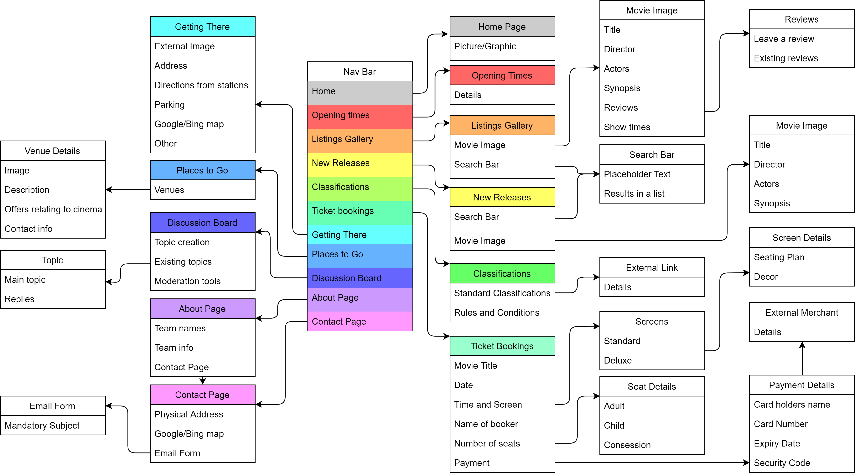
Introduction
How did we approach the Specification?

Slide 4
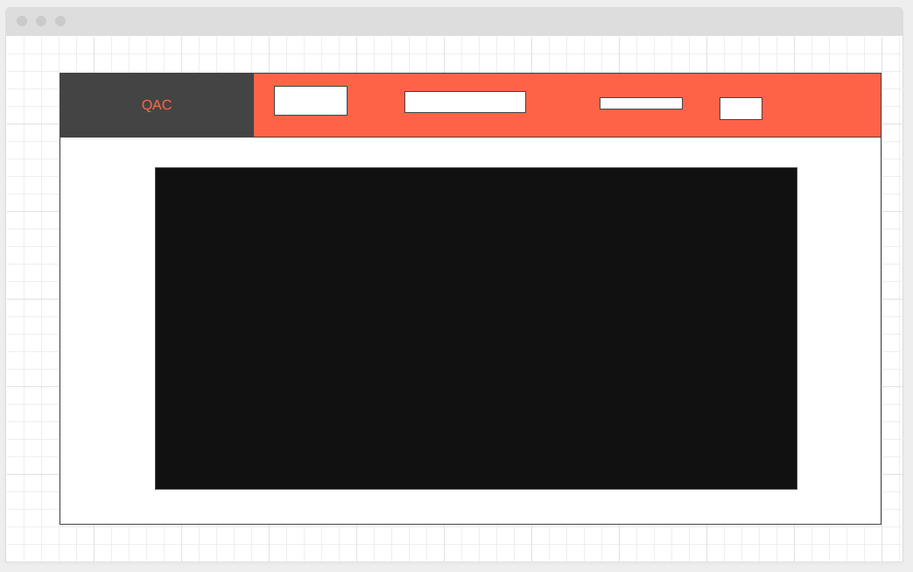
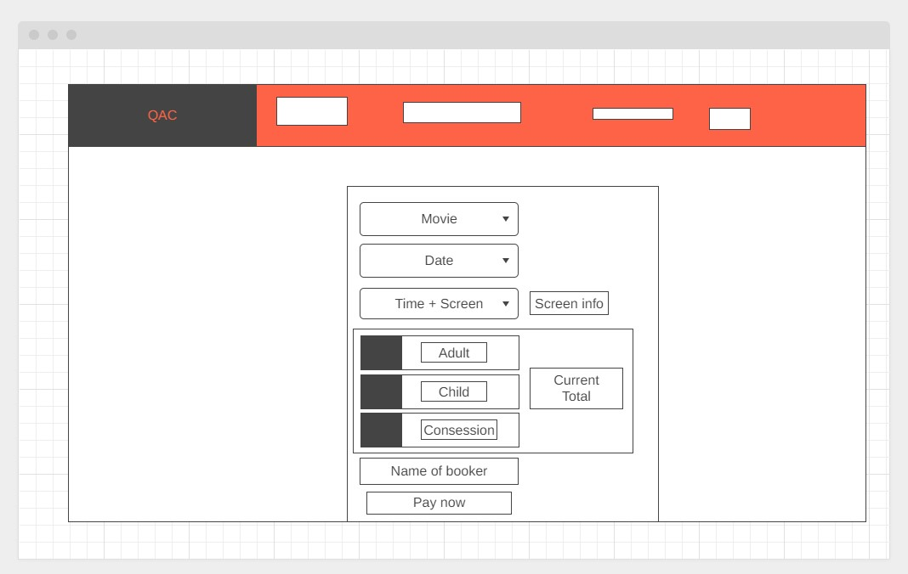
Concept

Slide 5
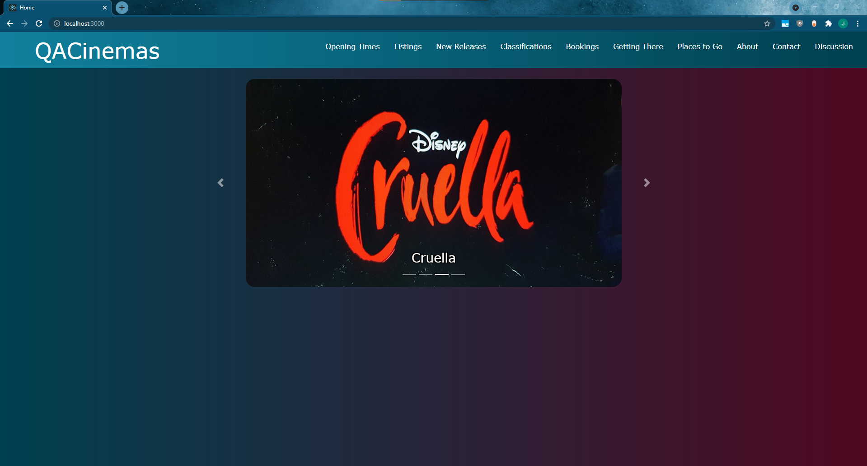
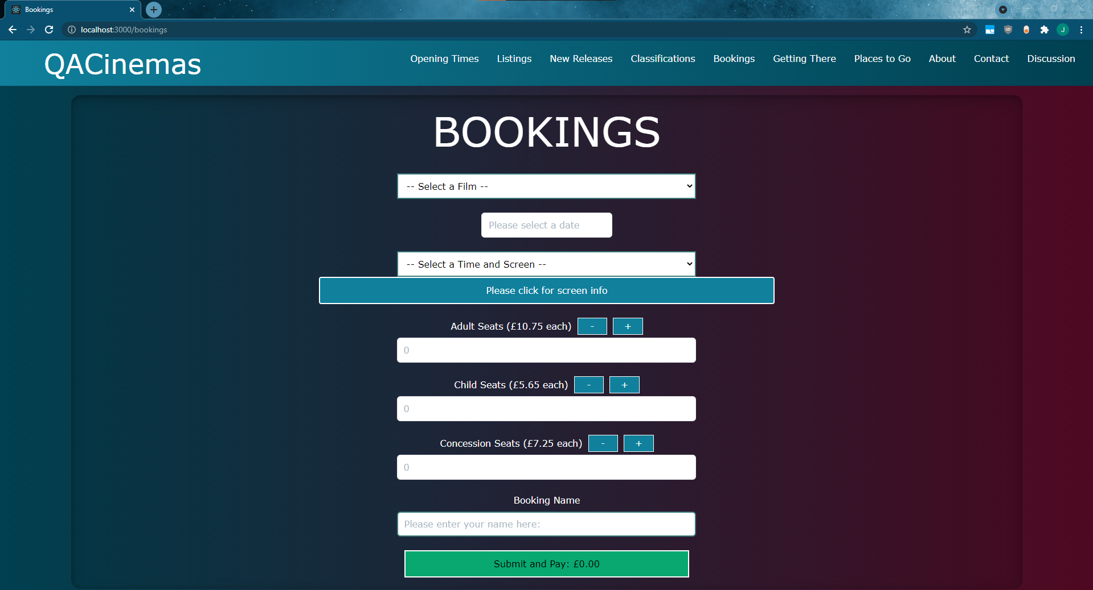
Concept

Slide 6
Sprint Plan
What needed to be included?
Front-end
Back-end
Testing
What did you hope to achieve?

Slide 7
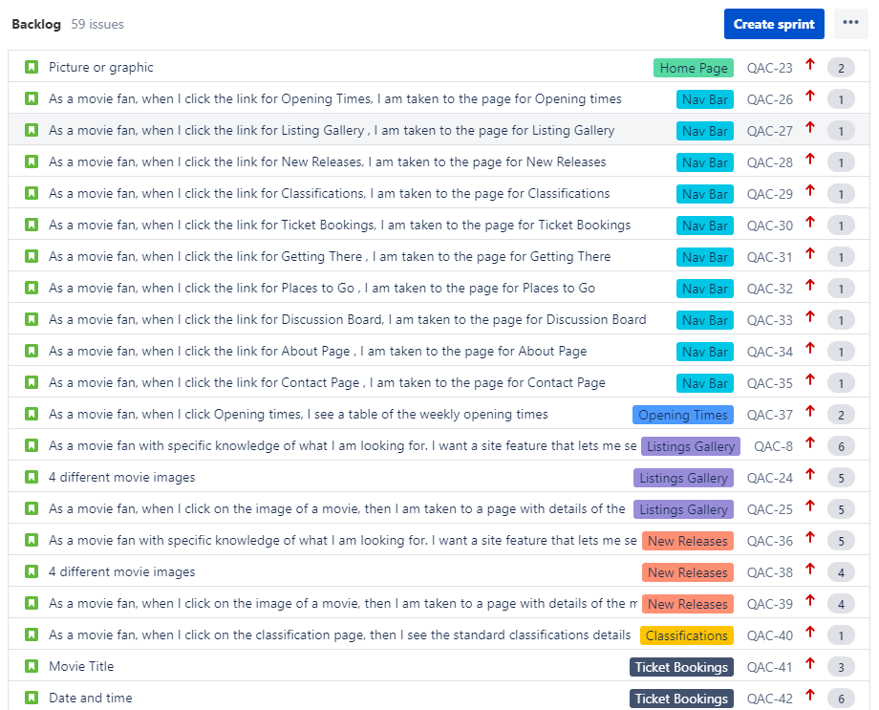
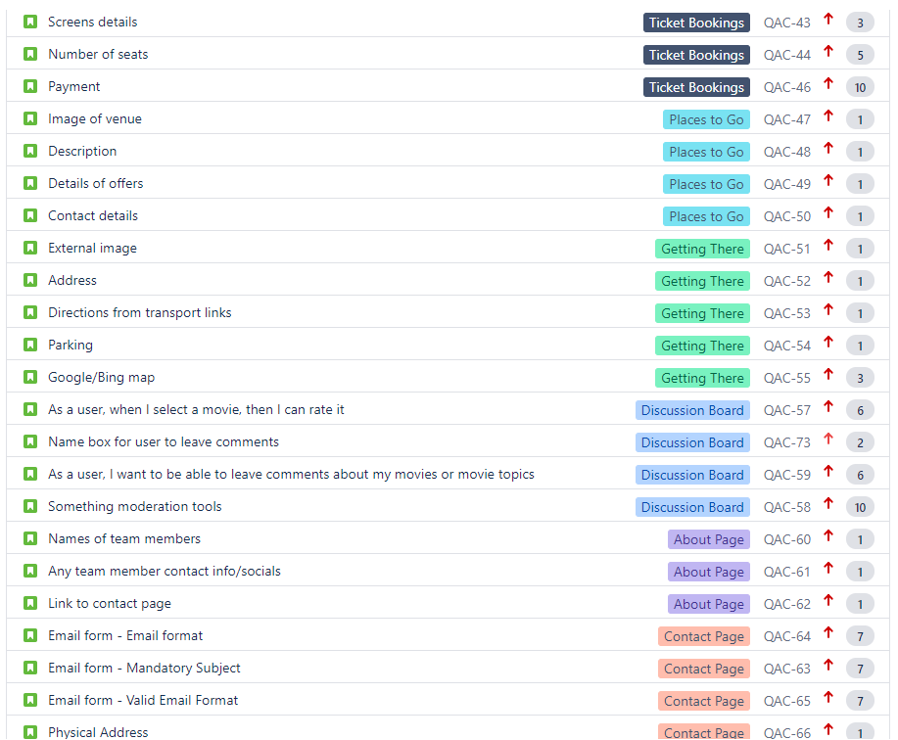
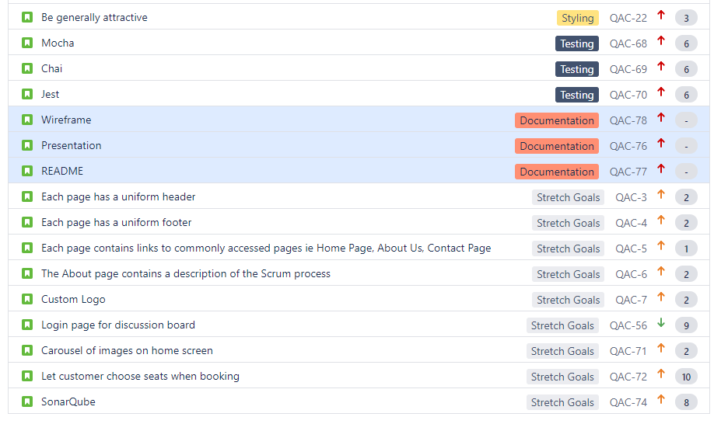

Slide 8




Consultant Journey
So what have we learnt?
MongoDB
Express
React
Node
Jest
Mocha
Chai

Slide 9
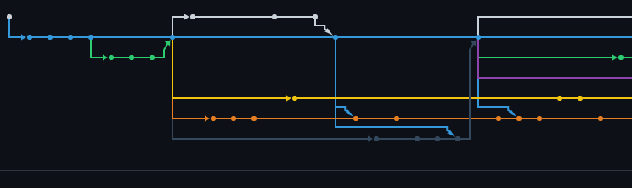
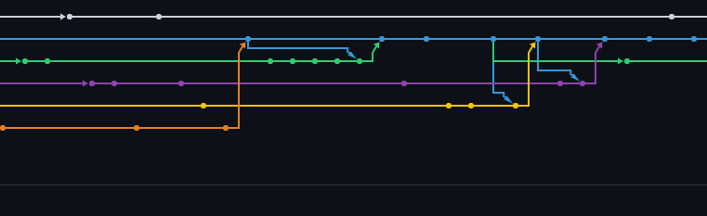
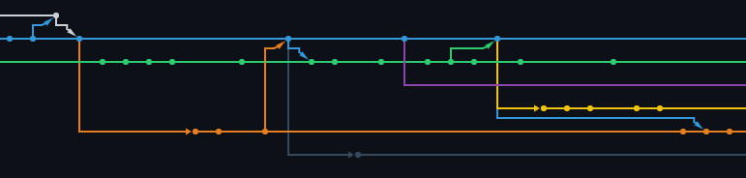
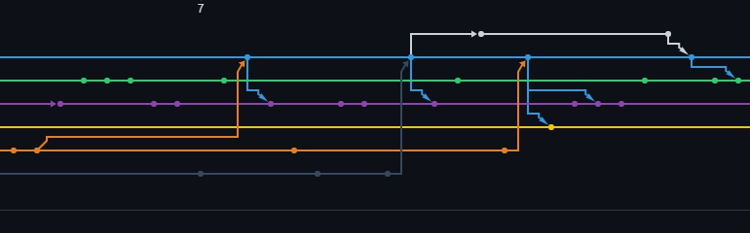
Continuous Integration

Slide 10
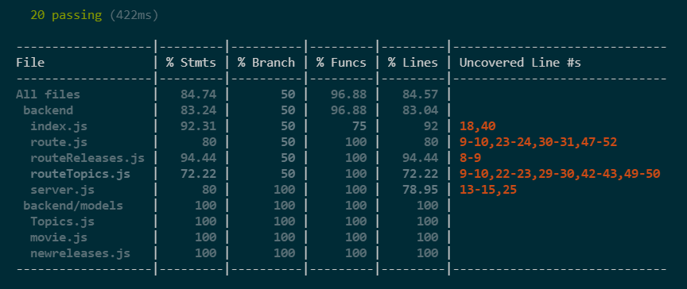
Testing

Slide 11
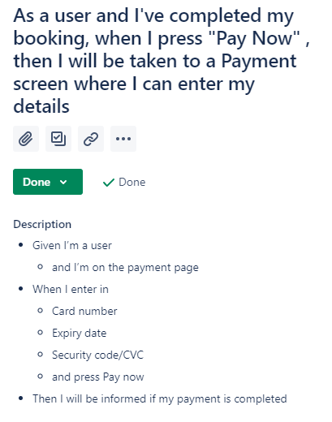
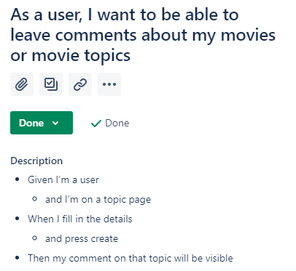
Demonstration

Slide 12
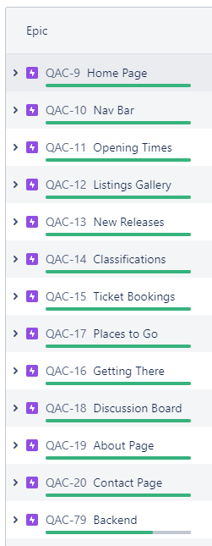
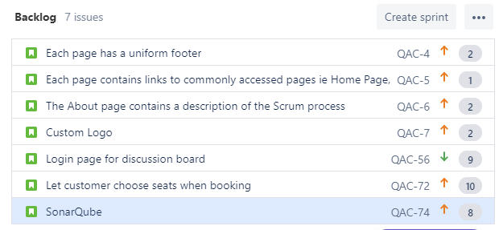
Sprint Review

Slide 13
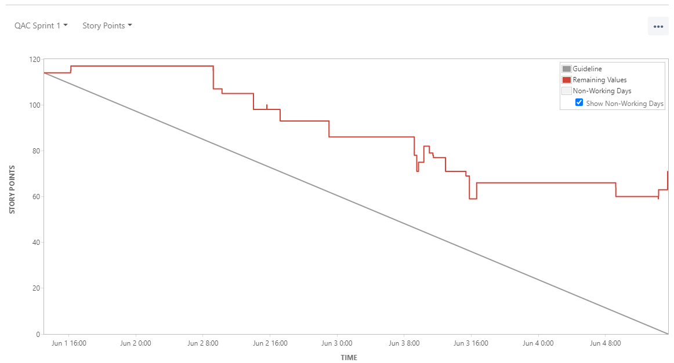
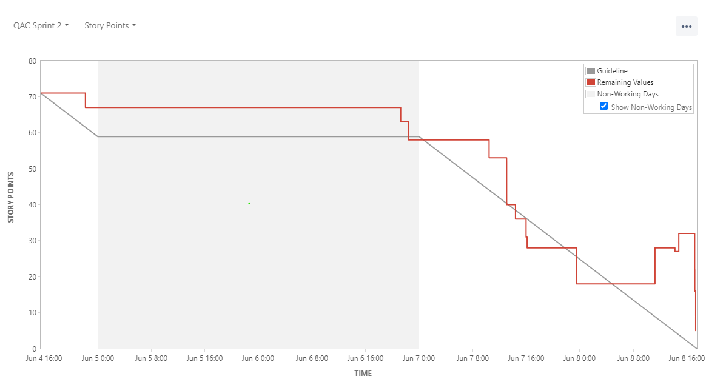
Sprint Retrospective

Slide 14
Conclusion
Project is a success
Room for improvement
Immensely pleased with the outcome
K.I.S.S. mentality

